Slide 1
Cloud Computing

Slide 2
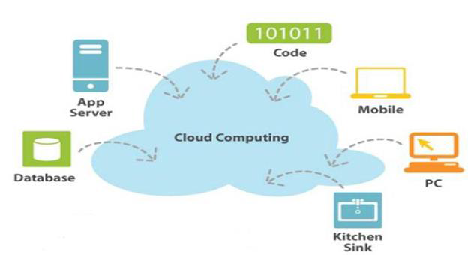
US National Institute of Standards and Technology (NIST)’s 3-4-5 definition

Slide 3
US National Institute of Standards and Technology (NIST) defines Computing as:
“ Cloud computing is a model for enabling ubiquitous, convenient, on-demand network access to a shared pool of configurable computing resources (e.g. networks, servers, storage, applications, and services) that can be rapidly provisioned and released with minimal management effort or service provider interaction. ”

Slide 4
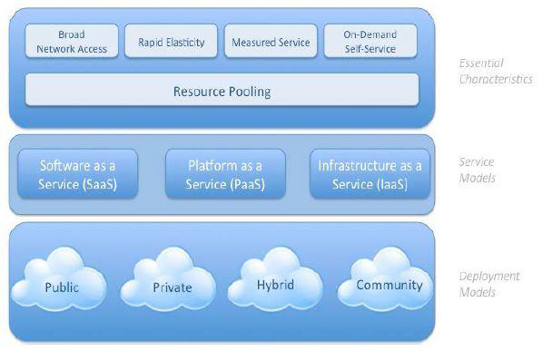
NIST Cloud Definition – Pictorial representation

Slide 5
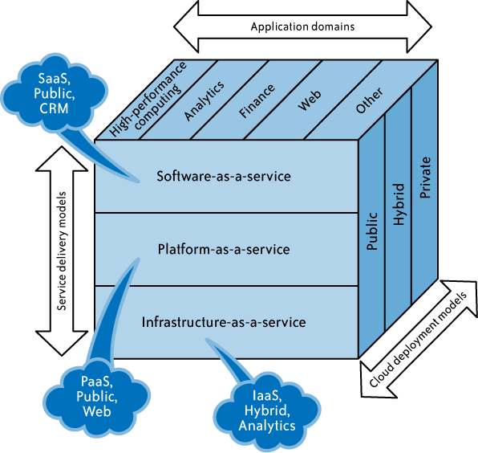
Cloud Computing (Definition)

Slide 6
Essential Characteristics
On-demand self-service
A consumer can unilaterally provision computing capabilities as needed automatically without requiring human interaction with each service provider.

Slide 7
Essential Characteristics
Broad network access
Capabilities are available over the network and accessed through standard mechanisms that promote use by heterogeneous thin or thick client platforms (e.g., mobile phones, tablets, laptops, and workstations).

Slide 8
Essential Characteristics
Resource pooling
The provider’s computing resources are pooled to serve multiple consumers using a multi-tenant model, with different physical and virtual resources dynamically assigned and reassigned according to consumer demand.

Slide 9
Essential Characteristics
Measured Service
Cloud systems automatically control and optimize resource use by leveraging a metering capability at some level of abstraction appropriate to the type of service .
Resource usage can be monitored, controlled, and reported, providing transparency for both the provider and consumer of the utilized service.

Slide 10
Essential Characteristics
Rapid elasticity
Capabilities can be elastically provisioned and released, in some cases automatically, to scale rapidly outward and inward commensurate with demand.
To the consumer, the capabilities available for provisioning often appear to be unlimited and can be appropriated in any quantity at any time.

Slide 11
Basic Concept of Internet Clouds

Slide 12
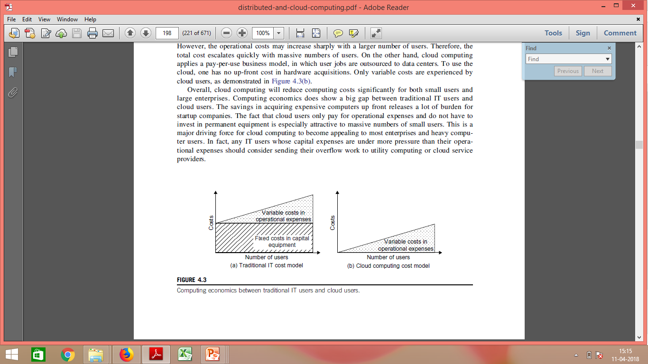
Cost Model

Slide 13
Traditional Cost Model
Users must acquire their own computer and peripheral equipment as capital expenses.
In addition, they have to face operational expenditures –
in operating and – (Power & cooling)
maintaining the computer systems,
including personnel and service costs.
The operational costs may increase sharply with a larger number of users.
Therefore, the total cost escalates quickly with massive numbers of users.

Slide 14
Cloud Computing Cost Model
Cloud computing applies a pay-per-use business model, in which user jobs are outsourced to data centers.
To use the cloud, one has no up-front cost in hardware acquisitions.
Only variable costs are experienced by cloud users

Slide 15
The Next Revolution in IT -Cloud Computing Cloud Ecosystem
Classical Computing
–Buy & Own
Hardware, System Software, Applications often to meet peak needs.
–Install, Configure, Test, Verify, Evaluate
–Manage
–..
–Finally, use it
–$$$$....$(High CapEx)
Cloud Computing
–Subscribe
–Use
–$ - pay for what you use, based on QoS

Slide 16
Cloud Design Objectives
The following list highlights six design objectives for cloud computing:
• Shifting computing from desktops to data centers
Computer processing, storage, and software delivery is shifted away from desktops and local servers and toward data centers over the Internet.
• Service provisioning and cloud economics
Providers supply cloud services by signing SLAs with consumers and end users. The services must be efficient in terms of computing, storage, and power consumption. Pricing is based on a pay-as-you-go policy.
• Scalability in performance
The cloud platforms and software and infrastructure services must be able to scale in performance as the number of users increases.

Slide 17
Cloud Design Objectives
Data privacy protection
Can you trust data centers to handle your private data and records? This concern must be addressed to make clouds successful as trusted services.
High quality of cloud services
The QoS of cloud computing must be standardized to make clouds interoperable among multiple providers.
New standards and interfaces
This refers to solving the data lock-in problem associated with data centers or cloud providers.
Universally accepted APIs and access protocols are needed to provide high portability and flexibility of virtualized applications.

Slide 18
Advantages of Cloud Computing
•Lower computer costs:
–No need of a high-powered and high-priced computer to run cloud computing's web-based applications.
–Since applications run in the cloud, not on the desktop PC, your desktop PC does not need the processing power or hard disk space demanded by traditional desktop software.
–When you are using web-based applications, your PC can be less expensive, with a smaller hard disk, less memory, more efficient processor...
–In fact, your PC in this scenario does not even need a CD or DVD drive, as no software programs have to be loaded and no document files need to be saved.

Slide 19
Advantages of Cloud Computing
•Improved performance:
–With few large programs hogging your computer's memory, you will see better performance from your PC.
–Computers in a cloud computing system boot and run faster because they have fewer programs and processes loaded into memory.
•Reduced software costs:
–Instead of purchasing expensive software applications, you can get most of what you need for free.
•most cloud computing applications today, such as the Google Docs suite.
–better than paying for similar commercial software
•which alone may be justification for switching to cloud applications.

Slide 20
Advantages of Cloud Computing
Instant software updates
–Another advantage to cloud computing is that you are no longer faced with choosing between obsolete software and high upgrade costs.
–When the application is web-based, updates happen automatically available the next time you log into the cloud.
–When you access a web-based application, you get the latest version without needing to pay for or download an upgrade.
Improved document format compatibility.
–You do not have to worry about the documents you create on your machine being compatible with other users' applications or OS.
–There are less format incompatibilities when everyone is sharing documents and applications in the cloud.

Slide 21
Advantages of Cloud Computing
Unlimited storage capacity
–Cloud computing offers virtually limitless storage.
–Your computer's current 1 Tera Bytes hard drive is small compared to the hundreds of Peta Bytes available in the cloud.
•Increased data reliability
–Unlike desktop computing, in which if a hard disk crashes and destroy all your valuable data, a computer crashing in the cloud should not affect the storage of your data.
•if your personal computer crashes, all your data is still out there in the cloud, still accessible

Slide 22
Advantages of Cloud Computing
Universal information access
–That is not a problem with cloud computing, because you do not take your documents with you.
–Instead, they stay in the cloud, and you can access them whenever you have a computer and an Internet connection
•Latest version availability
–When you edit a document at home, that edited version is what you see when you access the document at work.
–The cloud always hosts the latest version of your documents as long as you are connected, you are not in danger of having an outdated version.

Slide 23
Advantages of Cloud Computing
Easier group collaboration
–Sharing documents leads directly to better collaboration.
–Many users do this as it is an important advantages of cloud computing multiple users can collaborate easily on documents and projects
•Device independence
–You are no longer tethered to a single computer or network.
––Move to a portable device, and your applications and documents are still available.

Slide 24
Disadvantages of Cloud Computing
Requires a constant internet connection
–Cloud computing is impossible if you cannot connect to the Internet.
–Since you use the Internet to connect to both your applications and documents, if you do not have an Internet connection you cannot access anything, even your own documents.
–A dead Internet connection means no work and in areas where Internet connections are few or inherently unreliable, this could be a deal-breaker.

Slide 25
Disadvantages of Cloud Computing
Does not work well with low-speed connections
–Similarly, a low-speed Internet connection, such as that found with dial-up services, makes cloud computing painful at best and often impossible.
–Web-based applications require a lot of bandwidth to download, as do large documents.

Slide 26
Disadvantages of Cloud Computing
Features might be limited
–This situation is bound to change, but today many web-based applications simply are not as full-featured as their desktop-based applications.
For example, you can do a lot more with Microsoft PowerPoint than with Google Presentation's web-based offering

Slide 27
Disadvantages of Cloud Computing
Can be slow
–Even with a fast connection, web-based applications can sometimes be slower than accessing a similar software program on your desktop PC.
–Everything about the program, from the interface to the current document, has to be sent back and forth from your computer to the computers in the cloud.
–If the cloud servers happen to be backed up at that moment, or
–If the Internet is having a slow day, you would not get the instantaneous access you might expect from desktop applications.

Slide 28
Disadvantages of Cloud Computing
Stored data might not be secured
–With cloud computing, all your data is stored on the cloud.
•The questions is How secure is the cloud?
–Can unauthorized users gain access to your confidential data ?
Stored data can be lost!
–Theoretically, data stored in the cloud is safe, replicated across multiple machines.
–But on the off chance that your data goes missing, you have no physical or local backup.
•Put simply, relying on the cloud puts you at risk if the cloud lets you down.

Slide 29
Disadvantages of Cloud Computing
HPC Systems
–Not clear that you can run compute-intensive HPC applications that use MPI/OpenMP!
–Scheduling is important with this type of application as you want all the VM to be co-located to minimize communication latency!
General Concerns
–Each cloud systems uses different protocols and different APIs
•may not be possible to run applications between cloud based systems
–Amazon has created its own DB system (not SQL 92), and workflow system (many popular workflow systems out there)
•so your normal applications will have to be adapted to execute on these platforms.

Slide 30
Cloud Computing Challenges: Dealing with too many issues (Courtesy of R. Buyya)
Pricing
Scalability
Virtualization
Resource Metering
Reliability
QoS
Billing
Service Level
Agreements
Energy Efficiency
Provisioning
on Demand
Utility & Risk Management
Security
Legal & Regulatory
Privacy
Software Eng. Complexity
Trust
Programming Env. & Application Dev.

Slide 31
Service Models (XaaS)
Combination of Service-Oriented Infrastructure (SOI) and cloud computing realizes to XaaS.
X as a Service (XaaS) is a generalization for cloud-related services
XaaS stands for "anything as a service" or "everything as a service“
XaaS refers to an increasing number of services that are delivered over the Internet rather than provided locally or on-site
 XaaS is the essence of cloud computing.

Slide 32
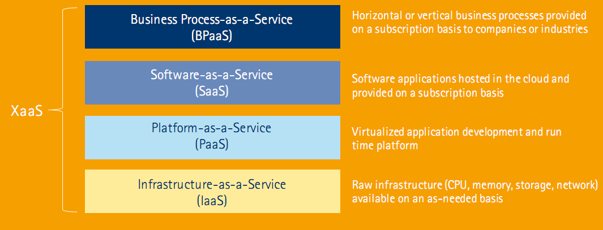
Service Models (XaaS)

Slide 33
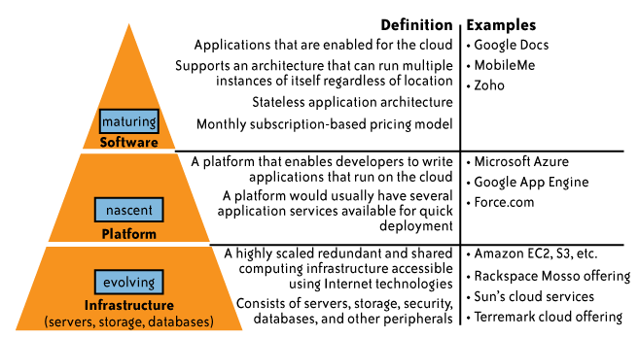
Service Models (XaaS)

Slide 34
Basic Service Models
SaaS - Software-as-a-Service Where the business subscribes to an application it accesses over the Internet.
PaaS - Platform-as-a-Service Where a business can create its own custom applications for use by all in the company.
IaaS - Infrastructure-as-a-Service
Where players like Amazon, Microsoft, Google, and Rackspace provide a backbone that can be "rented out" by other companies.
(IaaS is the game changer as it allows clients to fully outsourced service on demand rather than purchasing servers, software, datacenter space or network equipment.)
DaaS - Desktop-as-a-Service
DaaS is a cloud service where the back-end of a virtual desktop is hosted by a cloud provider.

Slide 35
Service Models (XaaS)
Most common examples of XaaS are
Software as a Service (SaaS)
Platform as a Service (PaaS)
Infrastructure as a Service (IaaS)
Other examples of XaaS include
Business Process as a Service (BPaaS)
Storage as a service (another SaaS)
Security as a service (SECaaS)
Database as a service (DaaS)
Monitoring/management as a service (MaaS)
Communications, content and computing as a service (CaaS)
Identity as a service (IDaaS)
Backup as a service (BaaS)
Desktop as a service (DaaS)

Slide 36
Simplified description of cloud service models
SaaS applications are designed for end users and are delivered over the web
PaaS is the set of tools and services designed to make coding and deploying applications quickly and efficiently
IaaS is the hardware and software that powers it all – servers, storage, network, operating systems

Slide 37
Software as a Service
SaaS is defined as software that is deployed over the internet.
With SaaS, a provider licenses an application to customers
a service on demand,
Either through a subscription, in a “pay-as-you-go” model, or
(increasingly) at no charge when there is opportunity to generate revenue from streams other than the user, such as from advertisement or user list sales.
E.g. of SaaS: Sales Force Customer Relationship Management (CRM) software

Slide 38
Applications where SaaS is used
•Applications where there is significant interplay between organization and outside world. √
E.g. email newsletter campaign software
•Applications that have need for web or mobile access. √
E.g. mobile sales management software.
•Software that is only to be used for a short term need. √
•Software where demand spikes significantly. √
E.g. Tax/Billing softwares.

Slide 39
Applications where SaaS may not be the best option
•Applications where extremely fast processing of real time data is needed √
•Applications where legislation or other regulation does not permit data being hosted externally √
•Applications where an existing on-premise solution fulfills all of the organization’s needs
√

Slide 40
Platform as a Service
PaaS can be defined as a computing platform that allows
creation of web applications quickly and easily and
without the complexity of buying and maintaining the software and infrastructure underneath it.

Slide 41
Platform as a Service
PaaS is analogous to SaaS except that,
Rather than being software delivered over the web, it is a platform for the creation of software, delivered over the web.
PaaS Examples: Microsoft Azure, Google App Engine

Slide 42
Scenarios where PaaS is used
PaaS is especially useful in any situation where
multiple developers will be working on a development project
Or where other external parties need to interact with the development process .
PaaS is useful where developers wish to automate testing and deployment services.

Slide 43
Scenarios where PaaS is used
The popularity of agile software development, a group of software development methodologies based on iterative and incremental development,
will also increase the uptake of PaaS as it eases the difficulties around rapid development and iteration of software.

Slide 44
Scenarios where PaaS is not ideal
•Where proprietary languages or approaches would impact on the development process
•Where a proprietary language would hinder later moves to another provider – concerns are raised about vendor lock in
•Where application performance requires customization of the underlying hardware and software
√
√
√

Slide 45
Infrastructure as a Service
•Infrastructure as a Service (IaaS) is a way of delivering Cloud Computing infrastructure – servers, storage, network and operating systems – as an on-demand service.
•Rather than purchasing servers,
software,
datacenter space or
network equipment,
clients instead buy those resources as a fully outsourced service on demand.

Slide 46
Scenarios where IaaS makes sense
Where demand is very volatile – any time there are significant spikes and troughs in terms of demand on the infrastructure
For new organizations without the capital to invest in hardware
Where the organization is growing rapidly and scaling hardware would be problematic

Slide 47
Scenarios where IaaS makes sense
Where there is pressure on the organization to limit capital expenditure and to move to operating expenditure
For specific line of business, trial or temporary infrastructural needs

Slide 48
Scenarios where IaaS may not be the best option
•Where regulatory compliance makes the offshoring or outsourcing of data storage and processing difficult.
•Where the highest levels of performance are required, and on-premise or dedicated hosted infrastructure has the capacity to meet the organization’s needs
√
√

Slide 49
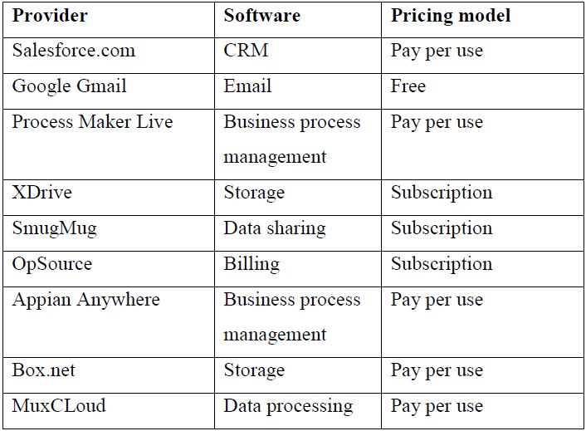
SaaS providers

Slide 50
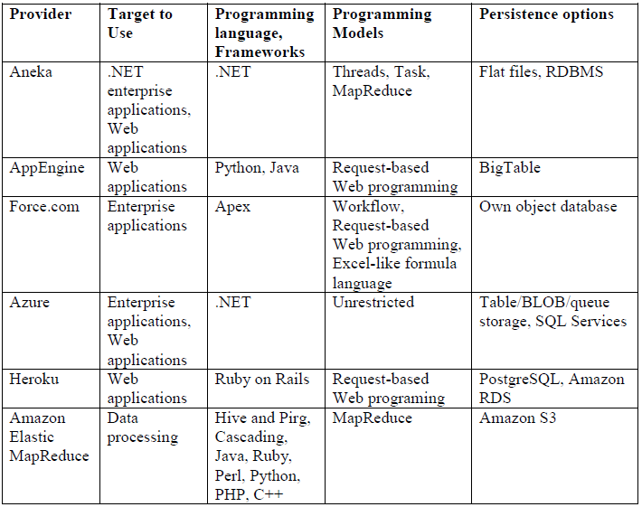
Feature comparison of PaaS providers

Slide 51
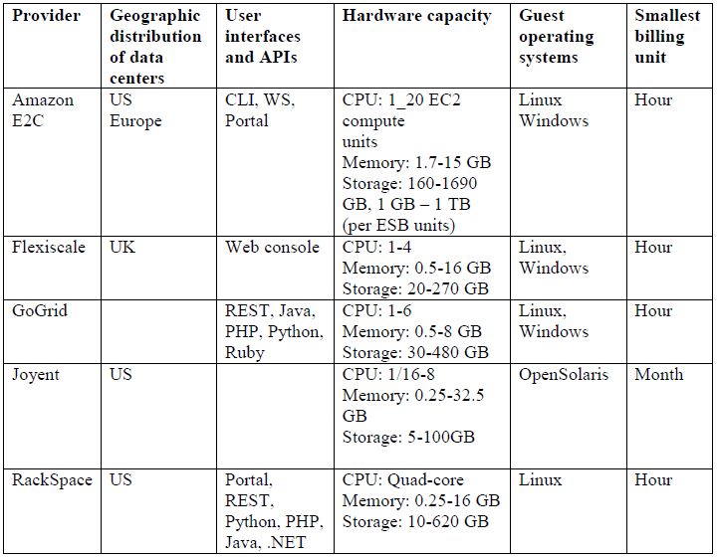
Feature comparison of IaaS providers

Slide 52
Deployment Models
Public Cloud
Private Cloud
Hybrid Cloud
Community Cloud

Slide 53
Public Cloud
used by whom?
owned, managed, and operated by ?
location?

Slide 54
Public Cloud
Cloud infrastructure is provisioned for open use by the general public.
It may be owned, managed, and operated by a business, academic, or government organization, or some combination of them.
It exists on the premises of the cloud provider.

Slide 55
Public Cloud
Examples of Public Cloud:
Google App Engine
Microsoft Windows Azure
IBM Smart Cloud
Amazon EC2

Slide 56
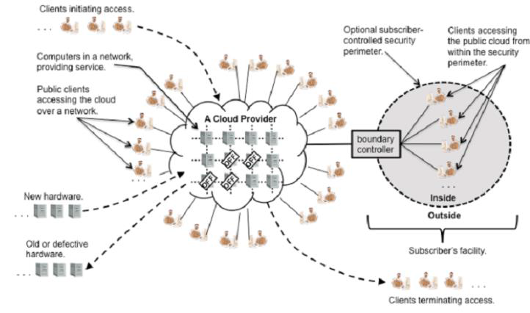
Public Cloud
In Public setting, the provider's computing and storage resources are potentially large;
the communication links can be assumed to be implemented over the public Internet; and
the cloud serves a diverse pool of clients (and possibly attackers).

Slide 57
Private Cloud
used by whom?
owned, managed, and operated by ?
premises/location?

Slide 58
Private Cloud
The cloud infrastructure is provisioned for exclusive use by a single organization comprising multiple consumers (e.g., business units).
It may be owned, managed, and operated by the organization, a third party, or some combination of them, and
it may exist on or off premises.

Slide 59
Private Cloud
Contrary to popular belief, private cloud may exist off premises and can be managed by a third party. Thus, two private cloud scenarios exist, as follows:
•On-site Private Cloud
–Applies to private clouds implemented at a customer’s premises.
•Outsourced Private Cloud
–Applies to private clouds where the server side is outsourced to a hosting company.

Slide 60
Private Cloud
Examples of Private Cloud:
–Eucalyptus
–Ubuntu Enterprise Cloud - UEC
–Amazon VPC (Virtual Private Cloud)
–VMware Cloud Infrastructure Suite
–Microsoft ECI data center.

Slide 61
Community Cloud
used by whom?
owned, managed, and operated by ?
premises/location?

Slide 62
Community Cloud
Cloud infrastructure is provisioned for exclusive use by a specific community of consumers
from organizations that have shared concerns e.g.
mission,
security requirements,
policy, and
compliance considerations

Slide 63
Community Cloud
It may be owned, managed, and operated by
one or more of the organizations in the community,
a third party, or
some combination of them, and
it may exist on or off premises.

Slide 64
Community Cloud
Examples of Community Cloud:
Google Apps for Government
Microsoft Government Community Cloud

Slide 65
Hybrid Cloud
The cloud infrastructure is a composition of two or more distinct cloud infrastructures (private, community, or public) that remain unique entities,
but are bound together by standardized or proprietary technology that enables data and application portability

Slide 66
Hybrid Cloud
Examples of Hybrid Cloud:
–Windows Azure (capable of Hybrid Cloud)
–VMware vCloud (Hybrid Cloud Services)
- Cloud Bursting for Load Balancing

Slide 67
Cloud Bursting for Load balancing
Cloud bursting is a configuration which is set up between a private cloud and a public cloud to deal with peaks in IT demand.
If an organisation using a private cloud reaches 100 percent of its resource capacity,
the overflow traffic is directed to a public cloud so there is no interruption of services.
It is the ability to allocate resources across various public and private clouds as an organization's needs change.

Slide 68
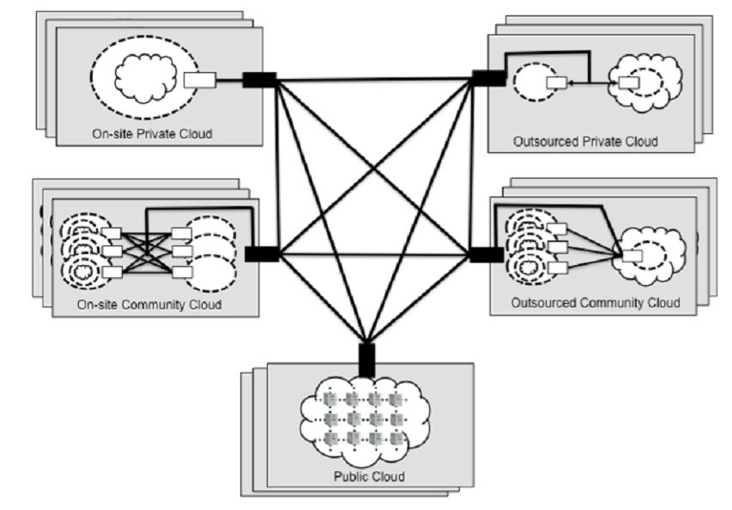
Hybrid Cloud
•A hybrid cloud is composed of two or more private, community, or public clouds.
•They have significant variations in performance, reliability, and security properties
depending upon the type of cloud chosen to build hybrid cloud.

Slide 69
Hybrid Cloud
•A hybrid cloud can be extremely complex
•A hybrid cloud may change over time with constituent clouds joining and leaving.

Slide 70
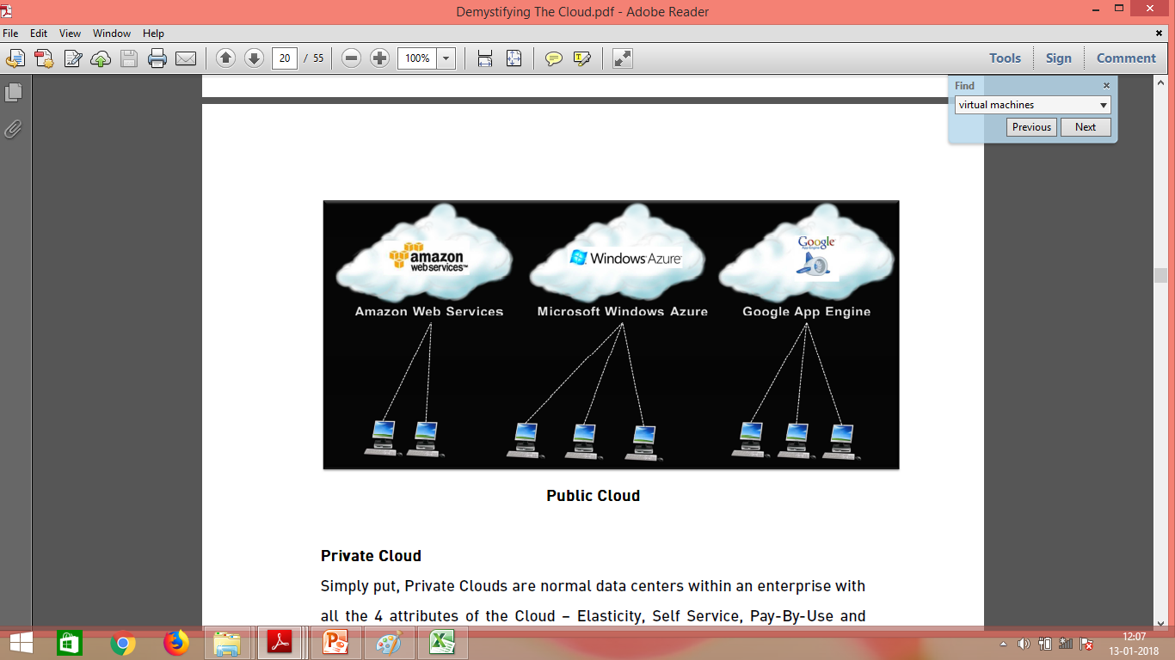
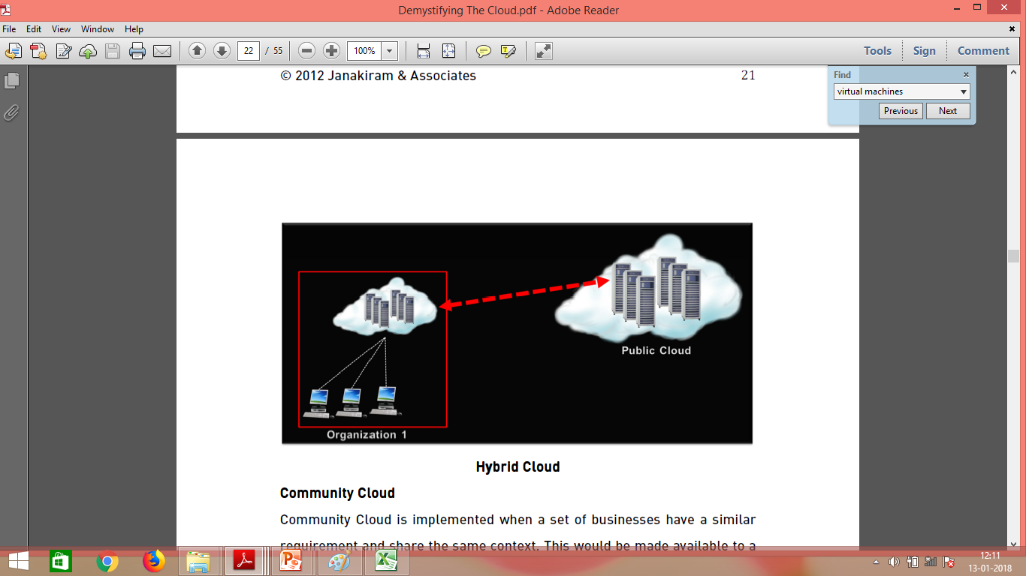
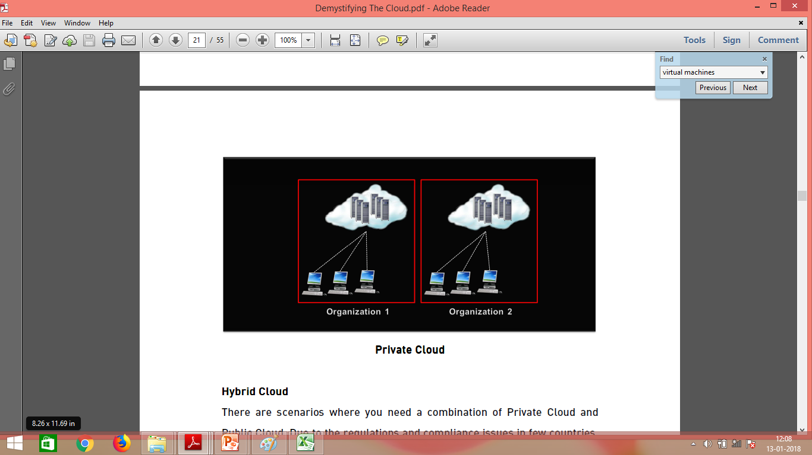
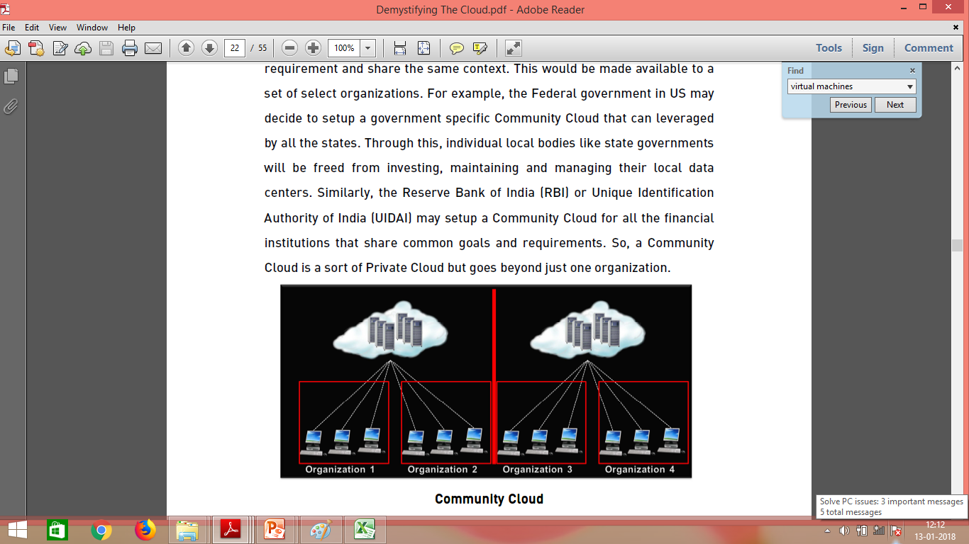

Slide 72
Types of Cloud (Deployment Models)
Private cloud
The cloud infrastructure is operated solely for an organization.
e.g Window Server 'Hyper-V'.
Community cloud
The cloud infrastructure is shared by several organizations and supports a specific goal.
Public cloud
The cloud infrastructure is made available to the general public
e.g Google Doc, Spreadsheet,
Hybrid cloud
The cloud infrastructure is a composition of two or more clouds (private, community, or public)
e.g Cloud Bursting for load balancing between clouds.

Slide 73
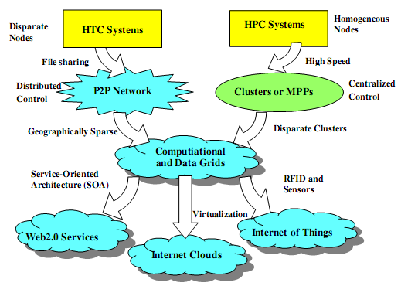
Evolutionary trend

Slide 74
HPC
HPC systems emphasize the raw speed performance.
The speed of HPC systems has increased from Gflops (early 1990s) to Pflops (2010).

Slide 75
FLOPS-
In computing, floating point operations per second (FLOPS) is a measure of computer performance, useful in fields of scientific computations.
Name | Unit | Value
kiloFLOPS | kFLOPS | 10³
megaFLOPS | MFLOPS | 10⁶
gigaFLOPS | GFLOPS | 10⁹
teraFLOPS | TFLOPS | 10¹²
petaFLOPS | PFLOPS | 10¹⁵
exaFLOPS | EFLOPS | 10¹⁸
zettaFLOPS | ZFLOPS | 10²¹
yottaFLOPS | YFLOPS | 10²⁴

Slide 76
HTC
High Throughput Computing.
HTC pays more attention to High flux computing.
High flux computing application is in Internet searches and web services by millions or more users simultaneously.
The performance goals thus shifts to measure high throughput or the number of tasks completed per unit of time.

Slide 77
HPC vs HTC
HPC tasks are characterized as needing large amounts of computing power for short periods of time,
HTC tasks also require large amounts of computing, but for much longer times (months and years, rather than hours and days).
HPC environments are often measured in terms of FLOPS.
The HTC community, however, is not concerned about operations per second, but rather operations per month or per year.
Therefore, the HTC field is more interested in how many jobs can be completed over a long period of time instead of how fast.
Courtesy: https://en.wikipedia.org/wiki/High-throughput_computing

Slide 78
On HPC Side-
On the HPC side, Supercomputers or MPPs (Massively Parallel Processors) are gradually replaced by clusters of Co-operative computers out of desire to share computing resources.

Slide 79
On HPC Side-
Clusters are collection of homogenous compute nodes that are physically connected in close range to one another.

Slide 80
On HTC Side-
P2P(Peer 2 Peer networks) are formed for distributed file sharing and content delivery applications.
P2P is built over many client machines and are globally distributed in nature.
P2P,Cloud computing and Web Services platforms are more focussed on HTC applications.

Slide 81
Clustering and P2P lead to development of Computational and data grids.

Slide 82
Compute grid
Compute grids allow you to take a computation, optionally split it into multiple parts, and execute them on different grid nodes in parallel.
Computation will perform faster as it now can use resources from all grid nodes in parallel.
Features include-
load balancing
fail-over
grid events
node metrics
Data grid
Data grids allow you to distribute your data across the grid.
The main goal of data grid is to provide as much data as possible from memory on every grid node and to ensure data coherency.
Features include-
data replication
data backups
data affinity/partitioning

Slide 83
How is Grid Computing Used?
All computing resources do not have to work on the same specific task, but can work on sub-tasks that collectively make up the end goal.
For example,
A research team might analyze weather patterns in the North Atlantic region,
Another team analyzes the south Atlantic region,
Both results can be combined to deliver a complete picture of Atlantic weather patterns.

Slide 84
How is Grid Computing Used?
Grid computing is especially useful when
different subject matter experts need to collaborate on a project but
do not necessarily have the means to immediately share data and computing resources in a single site.
By joining forces despite the geographical distance,
the distributed teams are able to leverage their own resources that contribute to a bigger effort.

Slide 85
3 New Computing Paradigms
Internet Clouds
Internet of things(IOT)
Web 2.0 services

Slide 86
3 New Computing Paradigms
The maturity of Radio frequency Identification(RFID), Global Positioning System(GPS) and sensor technologies has triggered the development of the Internet of things(IOT)
With the Introduction of SOA, Web Services became available.
Advances in Virtualization led to the growth of Internet Clouds.

Slide 87
Computing platforms and technologies
Development of a cloud computing application happens by leveraging platforms and frameworks that provide different types of services

Slide 88
Amazon Web Services (AWS)
Amazon has been a leader in providing public cloud services (http://aws.amazon.com/).
Amazon applies the IaaS model in providing its services.

Slide 89
Amazon web services (AWS)
Amazon web services (AWS) AWS offers comprehensive cloud IaaS services ranging from virtual
compute,
storage, and
networking to complete computing stacks.

Slide 90
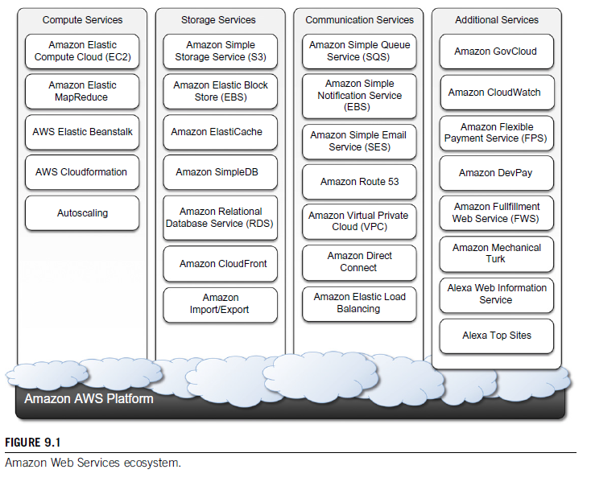
Amazon Web Services

Slide 91
Amazon web services (AWS)
AWS is mostly known for its compute and storage-on demand services, namely
Elastic Compute Cloud (EC2) and
Simple Storage Service (S3)

Slide 92
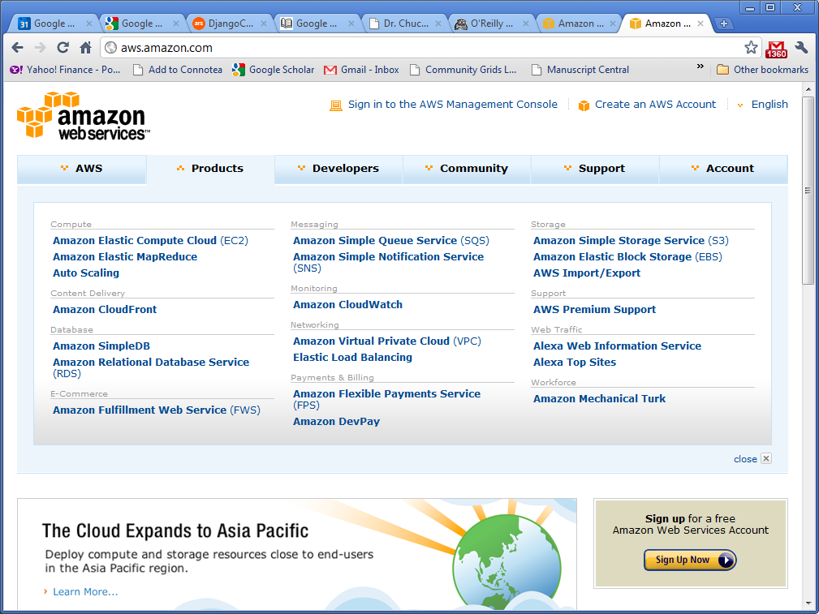
AWS Offerings

Slide 93
AWS
EC2 (Elastic Compute Cloud) provides the virtualized platforms to the host VMs where the cloud application can run.
S3 (Simple Storage Service) provides the object-oriented storage service for users.
EBS (Elastic Block Service) provides the block storage interface which can be used to support traditional applications.

Slide 94
Google App Engine (GAE)
Google’s App Engine (GAE) offers a PaaS platform supporting various cloud and web applications.

Slide 95
Google App Engine (GAE)
Google App Engine (often referred to as GAE or simply App Engine) is a cloud computing platform as a service for developing and hosting web applications in Google-managed data centers.
-Definition

Slide 96
Google AppEngine
AppEngine provides both a secure execution environment and a collection of services that simplify the development of scalable and high-performance Web applications.
The languages currently supported are Python, Java, and Go.

Slide 97
Google App Engine (GAE)
Google has hundreds of data centers and has installed more than 460,000 servers worldwide.
For example, 200 Google data centers are used at one time for a number of cloud applications.
Data items are stored in text, images, and video and are replicated to tolerate faults or failures.
Here we discuss Google’s App Engine (GAE) which offers a PaaS platform supporting various cloud and web applications.

Slide 98
Functional Modules of GAE
The application runtime environment offers a platform for scalable web programming and execution. It supports two development languages: Python and Java.

Slide 99
Google AppEngine
Developers can build and test applications on their own machines using the AppEngine software development kit (SDK),
which replicates the production runtime environment and
helps test and profile applications.
Once development is complete, developers can easily migrate their application to AppEngine,
set quotas to contain the costs generated, and
make the application available to the world.

Slide 100
Microsoft Azure
Microsoft Azure is a cloud operating system and a platform for developing applications in the cloud.
It provides a scalable runtime environment for Web applications and distributed applications in general.

Slide 101
Microsoft Azure
Applications in Azure are organized around the concept of roles, which identify a distribution unit for applications and embody the application’s logic.
Currently, there are three types of role:
Web role,
worker role, and
virtual machine role.

Slide 102
Microsoft Azure
The Web role is designed to host a Web application
The worker role is a more generic container of applications and can be used to perform workload processing
The virtual machine role provides a virtual environment in which the computing stack can be fully customized, including the operating systems.

Slide 103
Microsoft Azure
Besides roles, Azure provides a set of additional services that complement application execution, such as
support for storage (relational data and blobs),
networking,
caching,
content delivery, and others.

Slide 104
Parallel and Distributed Programming Models
Map Reduce
Hadoop

Slide 105
MapReduce
Applied mainly in web-scale search and cloud computing applications.
Web programming model for scalable data processing on large clusters over large data sets.
Parallel programming abstraction
Used by many different parallel applications which carry out large-scale computation involving thousands of processors

Slide 106
MapReduce
MapReduce is a programming model and an associated implementation for processing and generating big data sets with a parallel, distributed algorithm on a cluster.
A MapReduce program is composed of a map procedure, which performs filtering and sorting (such as sorting students by first name into queues, one queue for each name), and a reduce method, which performs a summary operation (such as counting the number of students in each queue, yielding name frequencies).

Slide 107
MapReduce Model
Two phases of MapReduce:
–Map operation
–Reduce operation
A configurable number of M ‘mapper’ processors and R ‘reducer’ processors are assigned to work on the problem
Computation is coordinated by a single master process

Slide 108

MapReduce Model Contd…
Map phase:
–Each mapper reads approximately 1/M of the input from the global file system, using locations given by the master
–Map operation consists of transforming one set of key-value pairs to another:

Slide 109
MapReduce Model Contd…
Map phase:
For eg-
3 Mappers, 2 Reducers,
Every mapper creates Two intermediate files, one per reducer
–Files are sorted by a key and stored to the local file system
–The master keeps track of the location of these files

Slide 110
MapReduce Model Contd…
Reduce phase:
–The master informs the reducers where the partial computations have been stored on local files of respective mappers
–Reducers make remote procedure call requests to the mappers to fetch the files

Slide 111

MapReduce Model Contd…
Reduce phase:
–Each reducer groups the results of the map step using the same key and performs a function f on the list of values that correspond to these key value:
–Final results are written back to the file system.

Slide 112
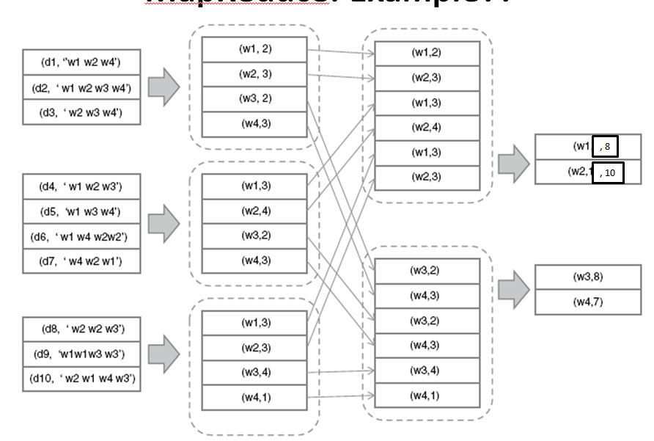


MapReduce: Example
3 mappers; 2 reducers
Map function:
Data d, Set of words w1,w2,w3…..wn
For every wi it produces count of it.
Reduce function:

Slide 113
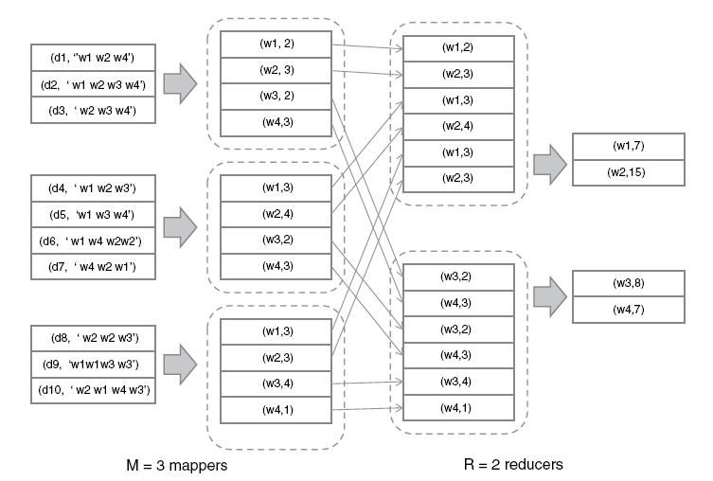
MapReduce: Example??
, 8
, 10

Slide 114
Hadoop Library
MapReduce: programming model developed at Google
Hadoop: open source implementation of MapReduce ,developed at Yahoo!

Slide 115
Hadoop Library
Hadoop provides the runtime environment, and
developers need only provide the input data and specify the map and reduce functions that need to be executed

Slide 116
Hadoop Library
Yahoo!, the sponsor of the Apache Hadoop project, has put considerable effort into transforming the project into an enterprise-ready cloud computing platform for data processing.
Hadoop is an integral part of the Yahoo! cloud infrastructure and supports several business processes of the company.
Currently, Yahoo! manages the largest Hadoop cluster in the world, which is also available to academic institutions

Slide 117
Hadoop Library
A Software platform to write and run applications over the vast amounts of distributed data.
Users can easily scale Hadoop to store and process petabytes of data in the web space.

Slide 118
Force.com
Force.com is a cloud computing platform for developing social enterprise applications.
PAAS soln
PAAS platform that helps developers and business users to build powerful enterprise applications.
Enterprise applications are large-scale software solutions designed to streamline and automate various processes of an organization’s operations.

Slide 119
Force.com allows developers to create applications
by composing ready-to-use blocks;
a complete set of components supporting all the activities of an enterprise are available
It is also possible to develop your own components or integrate those available in AppExchange into your applications.

Slide 120
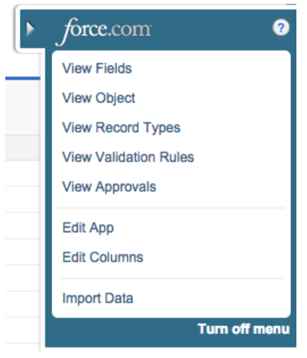
Force.com
If you buy some Force.com licenses and you would not have an out of the box solution.
You would have to build
Apps,
Tabs,
Custom Objects,
Workflow Rules
all yourself to design the kind of system that you want to use.
So when you are building Custom Objects and adding in Workflows, Approval Processes etc, this is all using Force.com.

Slide 121
SalesForce.com
SaaS product,
Customer Relationship Management System
Contains in-built Out of Box (OOB) functionalities that enables a CRM system to automate your sales, marketing, services, etc.

Slide 122
SalesForce.com
Force.com platform is the basis for SalesForce.com,
SalesForce.com Is a Software-as-a-Service solution for customer relationship management.

Slide 123
SalesForce.com
Salesforce.com is an out of the box solution with their three core products,
Sales Cloud,
Service Cloud and
Marketing Cloud.
You could go out and buy the Sales Cloud today and starting logging leads, opportunities, running reports etc.

Slide 124
Manjrasoft Aneka
Aneka is a platform and a framework for developing distributed applications on the Cloud.
It harnesses the spare CPU cycles of a heterogeneous network of desktop PCs and servers or datacenters on demand.
Aneka provides developers with a rich set of APIs for transparently exploiting such resources and expressing the business logic of applications by using the preferred programming abstractions.

Slide 125
Manjrasoft Aneka is a .NET-based platform and framework designed for building and deploying distributed applications on clouds.
Aneka is also a market-oriented cloud platform since it allows users to build and schedule applications, provision resources, and monitor results using pricing, accounting, and QoS/SLA services in private and/or public cloud environments.

Slide 126
Manjrasoft Aneka
A cloud application platform for
rapid creation of scalable applications and
their deployment on various types of clouds in a seamless and elastic manner.
PAAS soln

Slide 127
Manjrasoft Aneka
Developers can choose different abstractions to design their application:
tasks,
distributed threads, and
map-reduce
These applications are then executed on the distributed service-oriented runtime environment, which can dynamically integrate additional resource on demand

